Slide 1
DTD (Document Type Definition)

Slide 2
Introduction
A Document Type Definition (DTD) defines the legal building blocks of an XML document.
It defines the document structure with a list of legal elements and attributes.
A DTD can be declared inline inside an XML document, or as an external reference.

Slide 3
How to include DTD in xml
If the DTD is declared inside the XML file, it should be wrapped in a DOCTYPE definition with the following syntax:
  <!DOCTYPE root-element [element-declarations]>
If the DTD is declared in an external file, it should be wrapped in a DOCTYPE definition with the following syntax:
  <!DOCTYPE root-element SYSTEM "filename">

Slide 4
Building blocks of XML
XML documents (and HTML documents) are made up by the following building blocks:
  Elements
  Attributes
  Entities
  PCDATA
  CDATA

Slide 5
PCDATA & CDATA
PCDATA is text that WILL be parsed by a parser.
Tags inside the text will be treated as markup and entities will be expanded.
CDATA Character data is the text found between the start tag and the end tag of an XML element.
CDATA is text that will NOT be parsed by a parser.
Tags inside the text will NOT be treated as markup and entities will not be expanded.

Slide 6
DTD ELEMENTS

Slide 7
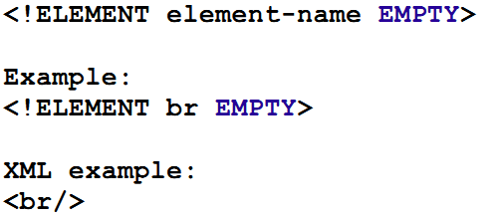
Declaration of Element
Empty elements are declared with the category keyword EMPTY
Like br, common elements are available such as bool, photo, hr, logo and so on.

Slide 8
Elements with PCDATA
Elements with only parsed character data are declared with #PCDATA inside parentheses:
<!ELEMENT element-name (#PCDATA)>
Example:
  <!ELEMENT from (#PCDATA)>

Slide 9
Elements with Children
Elements with one or more children are declared with the name of the children elements inside parentheses:
  <!ELEMENT element-name (child1)>
or
  <!ELEMENT element-name (child1,child2,...)>
Example:
<!ELEMENT note to,from,heading,body)>
When children are declared in a sequence separated by commas, the children must appear in the same sequence.

Slide 10
Occurrence of Element
One Occurences
One or More Occurences -- +
Zero or More Occurences - *
Zero or One Occurences -- ?
Either / Or ------------ |

Slide 11
Element with one occurrence
The example below declares that the child element "message" must occur once, and only once inside the "note" element.
  <!ELEMENT element-name (child-name)>
Example:
  <!ELEMENT note (message)>

Slide 12
Element with one or more occurrence
The + sign declares that the child element "message" must occur one or more times inside the "note" element.
  <!ELEMENT element-name (child-name+)>
Example:
  <!ELEMENT note (message+)>

Slide 13
Element with zero or more occurrence
The * sign declares that the child element "message" must occur zero or more times inside the "note" element.
  <!ELEMENT element-name (child-name*)>
Example:
  <!ELEMENT note (message*)>

Slide 14
Element with either or content
"note" element must contain either a "message" or a "body" element.
  <!ELEMENT note (message | body)>
Example:
  <!ELEMENT note (to,from,header,(message | body))>

Slide 15
DTD Attributes

Slide 16
Attribute Declaration
Attributes are declared with an ATTLIST declaration.
  <!ATTLIST element-name attribute-name attribute-type default-value>
DTD example:
  <!ATTLIST payment type CDATA "check">
XML example:
  <payment type="check" />

Slide 17
Default value
Value Explanation
-------------------------------------------------
value The default value of the attribute
#REQUIRED The attribute is required
#IMPLIED The attribute is not required
#FIXED value The attribute value is fixed

Slide 18
Attribute Types
  Type Description
  ------------------------------------------------------------------------------
  CDATA The value is character data
  (en1|en2|..) The value must be one from an enumerated list
  ID The value is a unique id
  IDREF The value is the id of another element
  IDREFS The value is a list of other ids
  NMTOKEN The value is a valid XML name
  NMTOKENS The value is a list of valid XML names
  ENTITY The value is an entity
  ENTITIES The value is a list of entities
  NOTATION The value is a name of a notation
  xml: The value is a predefined xml value

Slide 19
ID Attribute Type
The value of the ID attribute must not appear more than once throughout the XML document.
ID resembles the primary key concept used in databases.
  <ATTLIST question no ID #REQUIRED>
  <ATTLIST employee id ID #REQUIRED>
  <ATTLIST car serial ID #REQUIRED>

Slide 20
IDREF Attribute
Similar to foreign key concept used in databases. IDREF is used to establish connection between elements.
IDREF value of the attribute must refer to an ID value declared elsewhere in the document.
<ATTLIST question no ID #REQUIRED>
<ATTLIST answer qno IDREF #REQUIRED>

Slide 21
…CONTD
<question no =“Q1”>
What is the full form of DTD
</question>
<question no =“Q2”>
What is the full form of XML
</question>
<answer qno=“Q1”>
Document Type Definition
</answer>

Slide 22
IDREFS Attribute
List of ID values separated by white spaces
  <ATTLIST student roll ID #REQUIRED>
  <ATTLIST answer sid ID #REQUIRED>
  <ATTLIST marks ref IDREFS #REQUIRED>
Example
  <student rollno=‘r01’>Samir</student>
  <subject sid=‘s1’>Web Technology</subject>
  <marks ref=‘r01 s1’>82</marks>
In this way connections among set of elements can be established with IDREF attribute

Slide 23
…Contd
List of ID values separated by white spaces
  <ATTLIST employee id ID #REQUIRED>
  <ATTLIST managers emp IDREFS #REQUIRED>
<employee id=‘e01’>Rahul</employee>
<employee id=‘e02’>Mithra</employee>
<employee id=‘e03’>Sharma</employee>
<managers emp=‘e01 e03’/>
Rahul and Sharma are Managers

Slide 24
DTD: Default value
  <!ELEMENT square EMPTY>
  <!ATTLIST square width CDATA "0">
Valid XML:
  <square width="100" />
How to use the default value for square element?

Slide 25
DTD:
  <!ATTLIST person number CDATA #REQUIRED>
Valid XML:
  <person number="5677" />
Invalid XML:
  <person />

Slide 26
DTD:
  <!ATTLIST contact fax CDATA #IMPLIED>
Valid XML:
  <contact fax="555-667788" />
Valid XML:
  <contact />
DTD:
  <!ATTLIST sender company CDATA #FIXED "Microsoft">
Valid XML:
  <sender company="Microsoft" />
Invalid XML:
  <sender company="W3Schools" />

Slide 27
Attribute with enumerated values
Syntax:
<!ATTLIST element-name attribute-name (en1|en2|..) default-value>
DTD:
  <!ATTLIST payment type (check|cash) "cash">
XML example:
  <payment type="check" />
OR
  <payment type="cash" />

Slide 28
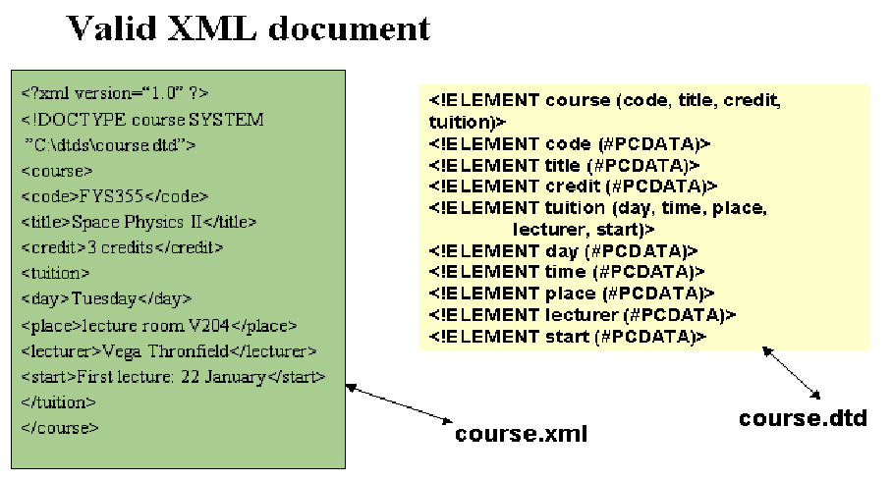

Slide 29
DTD Entities
Entities are variables used to define shortcuts to standard text or special characters.
Entity references are references to entities
Entities can be declared internal or external

Slide 30
Internal Entity Declaration
An entity has three parts: an ampersand (&), an entity name, and a semicolon (;)
  Syntax: <!ENTITY entity-name "entity-value">
DTD Example:
  <!ENTITY writer "Donald Duck.">
  <!ENTITY copyright "Copyright W3Schools.">
XML example:
  <author>&writer;&copyright;</author>
This will be interpreted as
  <author> Donald Duck Copyright W3Schools</author>

Slide 31
External Entity Declaration
This is used for the long replacement of text that is kept in another file
Useful in creating common references that can be shared across multiple documents’
Changes made in the external entities are automatically updated in the documents they are referenced
  <!ENTITY entity-name SYSTEM ‘URI’>
  <!ENTITY author SYSTEM ‘author.xml’>

Slide 32
Author.xml
  <firstname>Uttam</firstname>
  <middlename>Kumar</middlename>
  <lastname>Roy</lastname>
Another.xml
  <book>&author;</book> will produde the following
<book>
  <firstname>Uttam</firstname>
  <middlename>Kumar</middlename>
  <lastname>Roy</lastname>
</book>

Slide 33
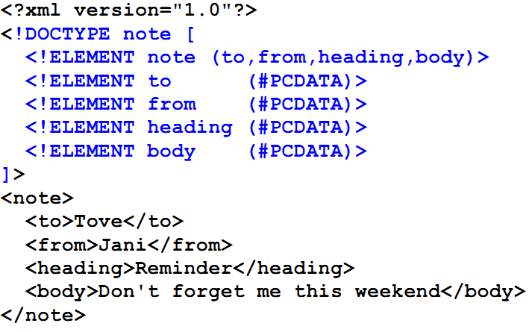
Internal DTD Declarartion

Slide 34
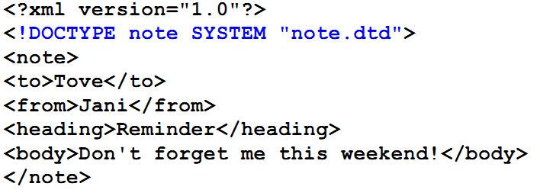
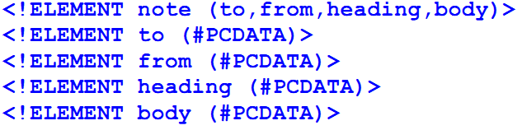
External DTD Declaration

Slide 35
DTD can be used by both the sender and receiver.
Sender – uses the DTD to create valid XML documents.
Receiver – uses the DTD to check the validity of incoming
XML document and determine if the incoming XML data is valid with respect to DTD.

Slide 36
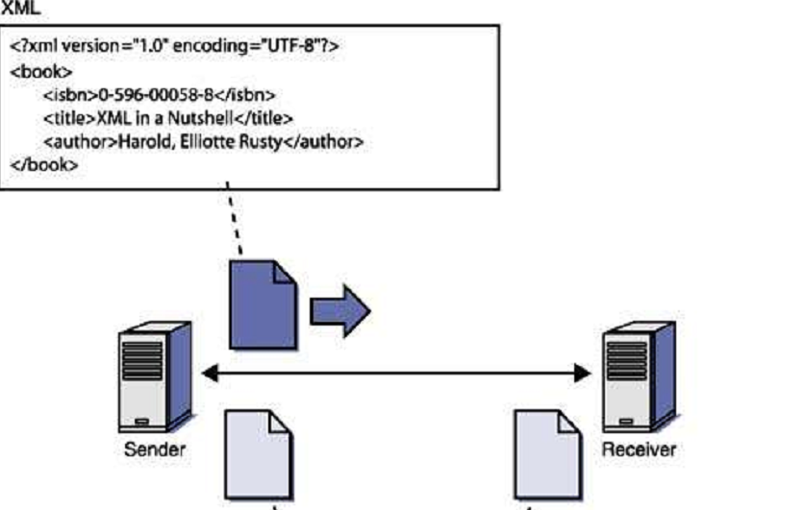
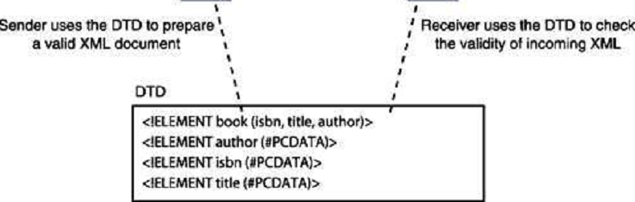

Slide 37
Limitations of DTD
DTDs are written using a different syntax from XML.
DTDs are not able to define distinctions about data types.
A DTD is limited to declaring that an element must contain text.
  Example: no distinctions among numeric or alphabet
Solution:
  XML Schema is evolved

